Slide 1

Magnetosheath jets using MMS: classification and generation mechanisms Savvas Raptis¹, Tomas Karlsson¹, Ferdinand Plaschke², Anita Kullen¹, P-A. Lindqvist¹ ¹Division of Space and Plasma Physics, KTH Royal Institute of Technology, Sweden ²Space Research Institute, Austrian Academy of Sciences, Graz, Austria COSPAR 2021 31/01/2021

Slide 2
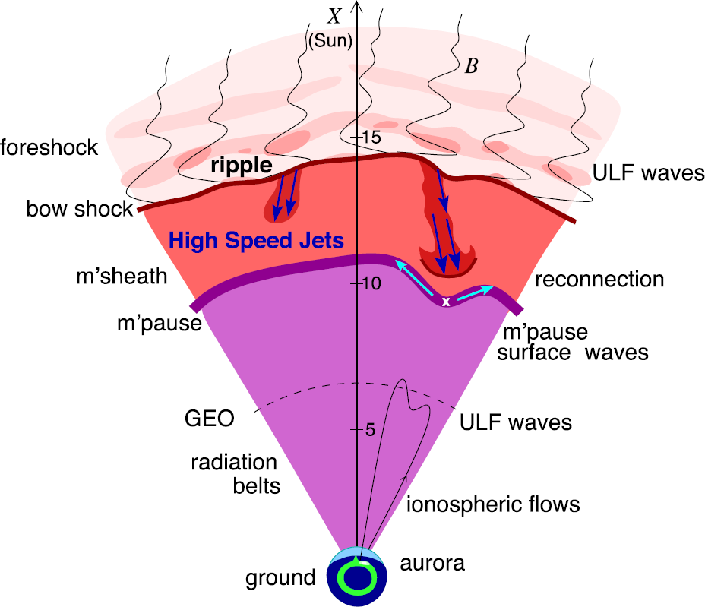
Introduction – Magnetosheath Jets
Plaschke F. et al. (2018); sketch by H. Hietala | Space Sci. Rev

Slide 3
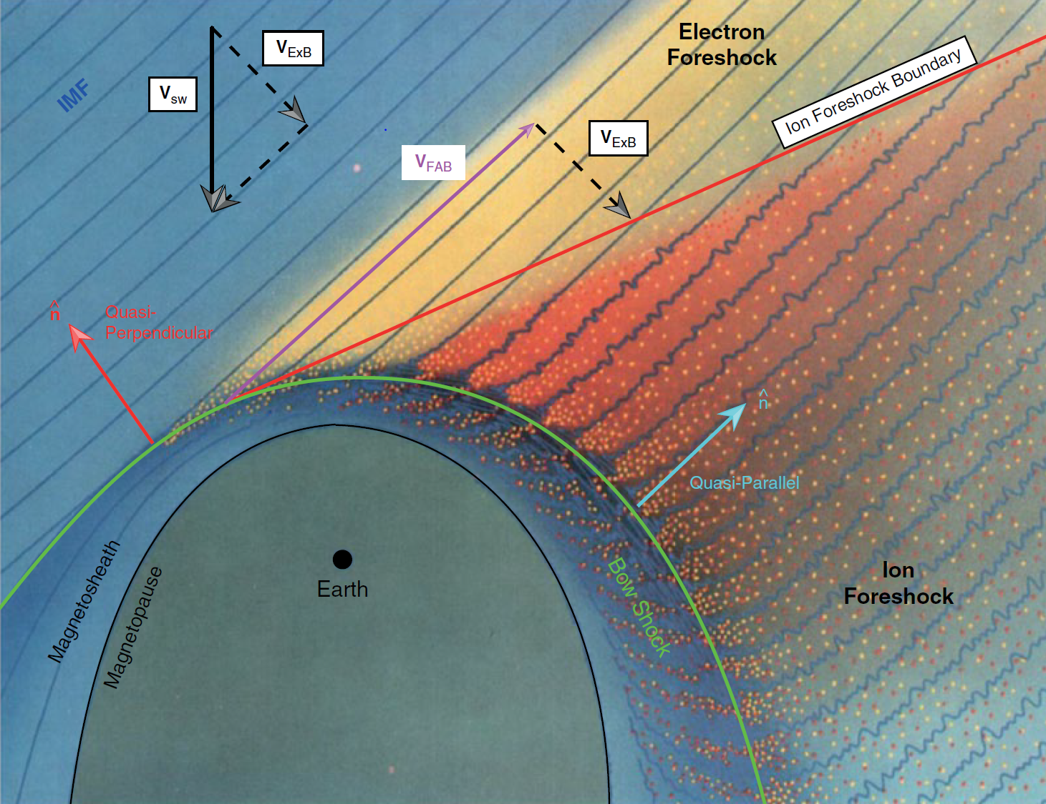
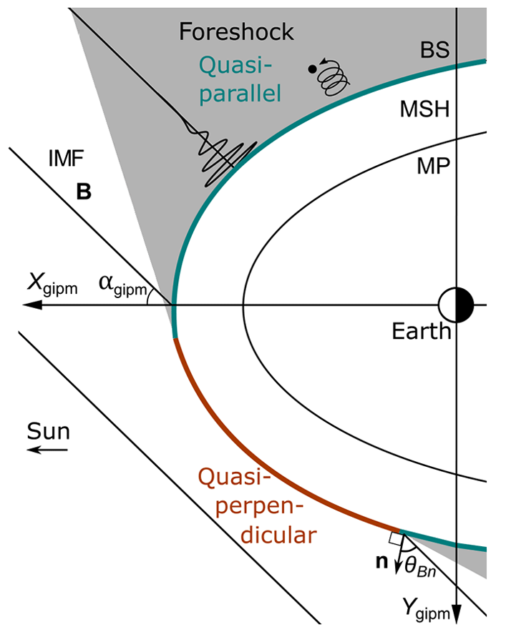

Motivation – Main Subcategories
”Found ~9 times more often behind the Qpar bow shock”
$$Q_{par}$$ | $$Q_{per}$$
L. B. Wilson (2016) | Geophysical Monograph Series
Vuorinen, et al. (2019) | Annales

Slide 4
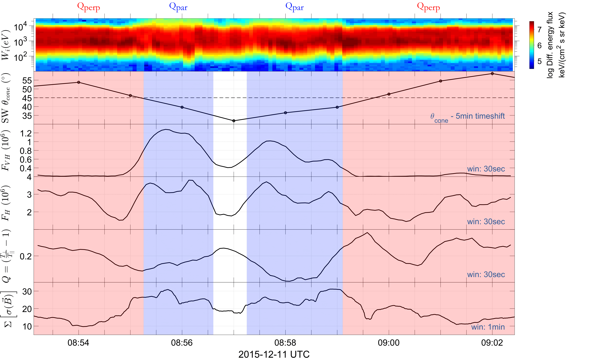
Classification Procedure in progress
Cone Angle
Very High Energy
Flux
High Energy Flux
Anisotropy
Magnetic Field
stdev
Raptis, Karlsson, et al. (2020) | JGR
Karlsson, Raptis, et al. (2020) | Ongoing

Slide 5
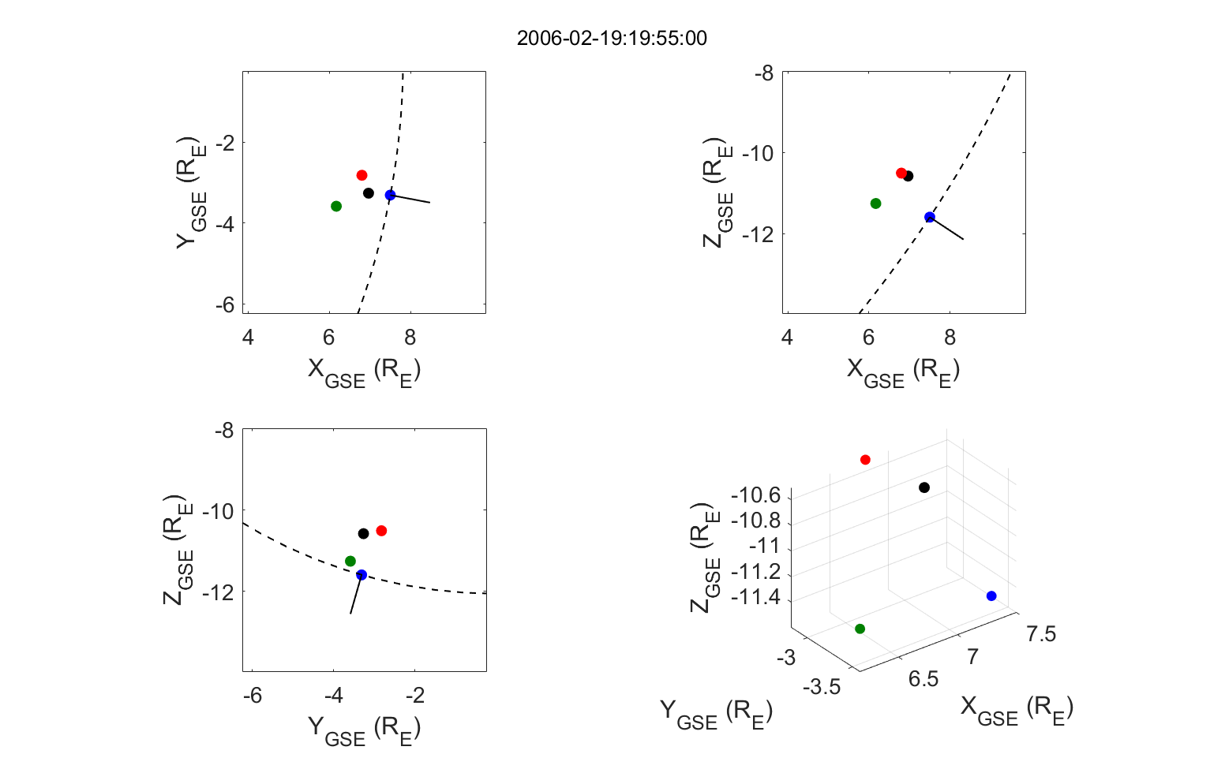
Classification using Cluster
Multispacecraft validation
Karlsson, Raptis, et al. (2020) | Ongoing

Slide 6
Classification using Cluster
Multispacecraft validation
Karlsson, Raptis, et al. (2020) | Ongoing

Slide 7
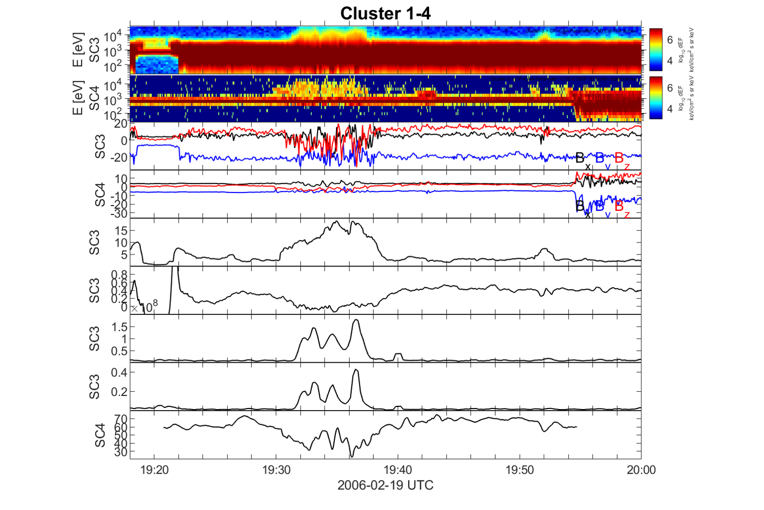
Classification using Cluster
Magnetic Field
Magnetic Field
Magnetic Field
stdev
Anisotropy
High Energy Flux
Energy Flux Ratio
Theta Bn
Karlsson, Raptis, et al. (2020) | Ongoing

Slide 8


Qpar and Qperp Jets
Qpar Jet
Qperp Jet
Jets found in $Q_{∥}$ MSH
Jets found in $Q_{∥}$ MSH
Raptis S., Karlsson T., et al. (2020) | JGR
Raptis S., Aminalragia-Giamini S., et al. (2020) | Frontiers

Slide 9
“Jets are there but we are not 100% sure why and how “

Slide 10
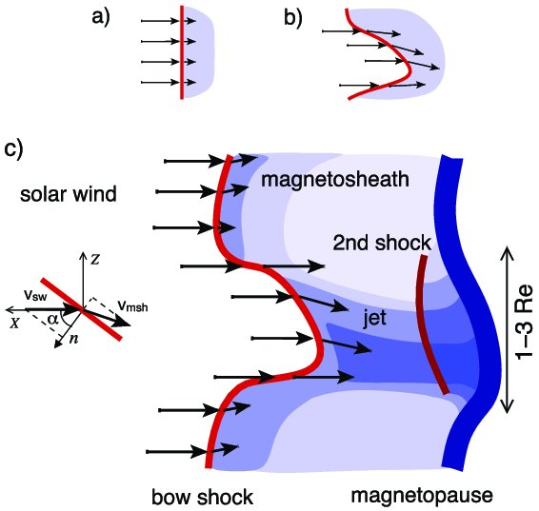
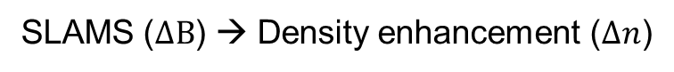
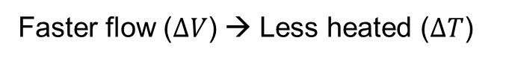
Connecting to existent mechanisms
Bow shock ripples
SLAMS penetration
Fast plasmoid
Embedded plasmoid
SLAMS
BS
v
SLAMS
v
v
Faster flow ($ΔV$) → Less heated ($ΔT$)
SLAMS ($ΔB$) → Density enhancement ($Δn$)
Qpar : Hietala et al., (2009,2012) | Qperp : Johlander et al. (2016)
Hietala et al., (2009,2012), Karlsson et al. (2015)
Notes:
Mention DT vs DV
Mention DB vs Dn

Slide 11
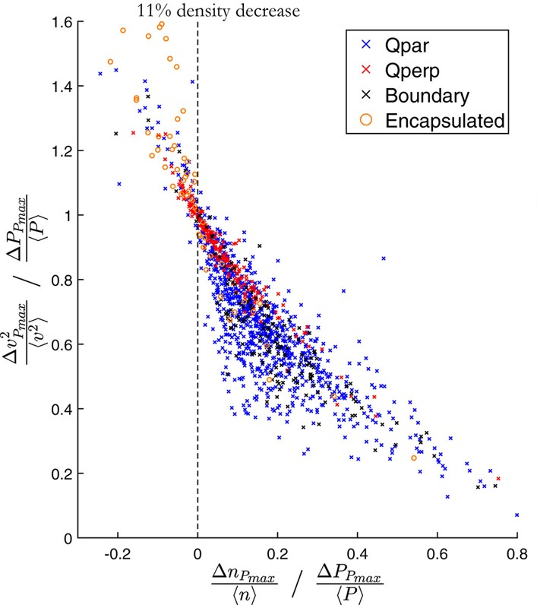
Current main results (1)
Raptis S., Karlsson T., et al. (2020) | JGR
Raptis S., Aminalragia-Giamini S., et al. (2020) | Frontiers

Slide 12
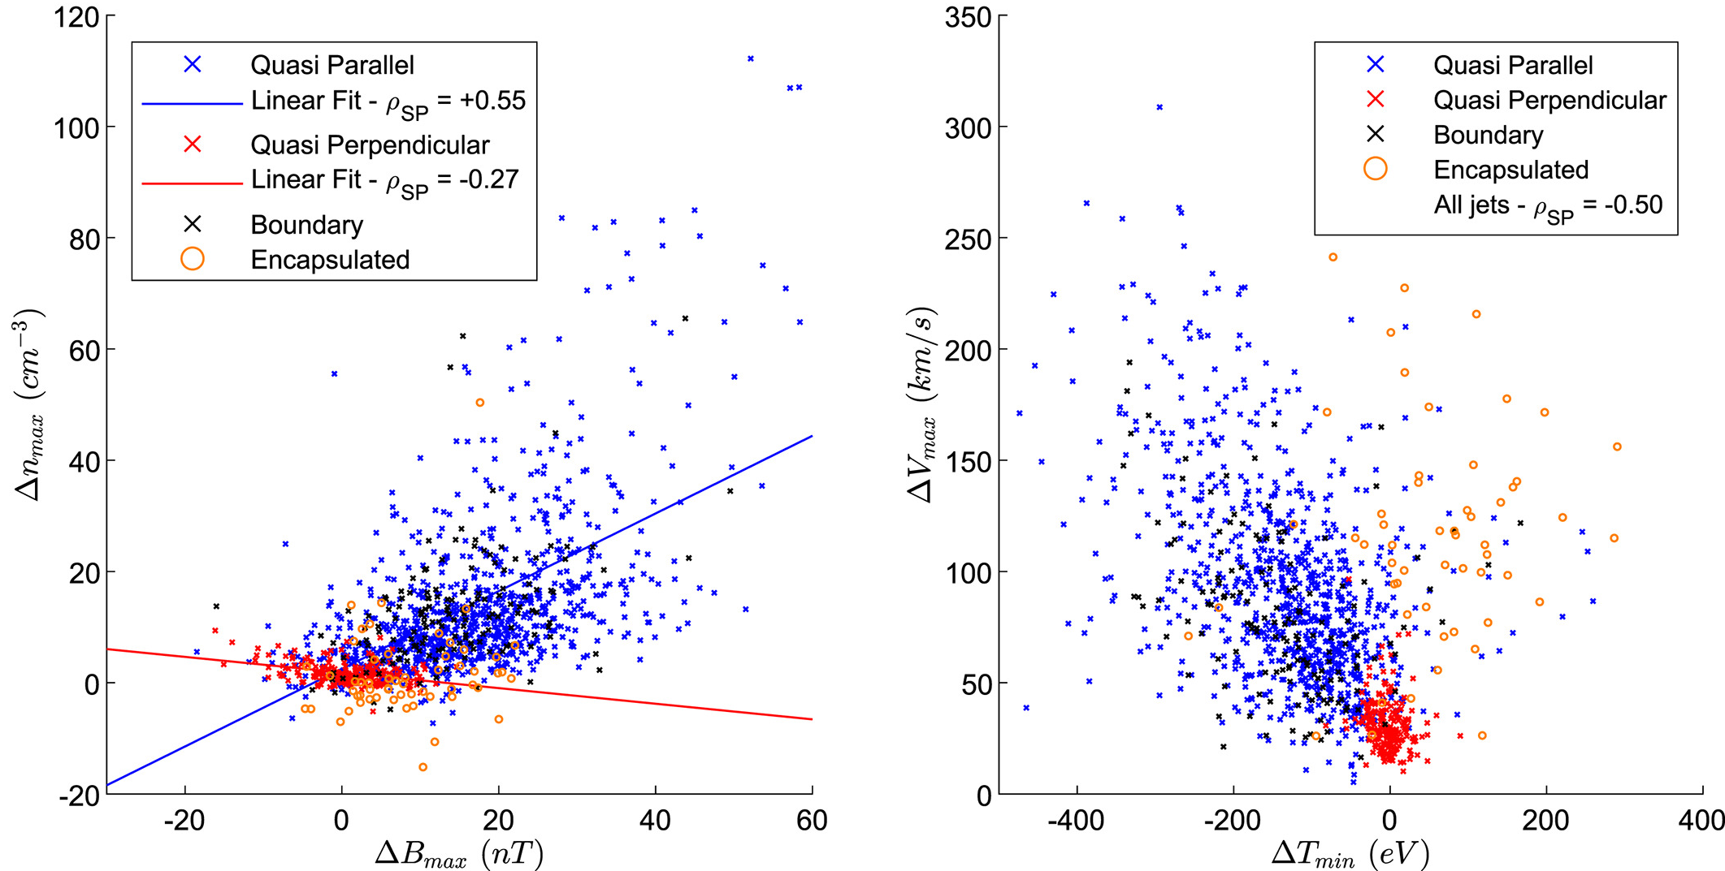
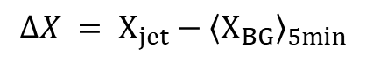
Current main results (2)
SLAMS
$$ΔX = Χ_{jet}−{\left\langle Χ_{BG}\right\rangle }_{5min}$$
Ripples
Raptis S., Karlsson T., et al. (2020) | JGR

Slide 13
Ongoing Work
Raptis, Karlsson, et al. | Ongoing

Slide 14
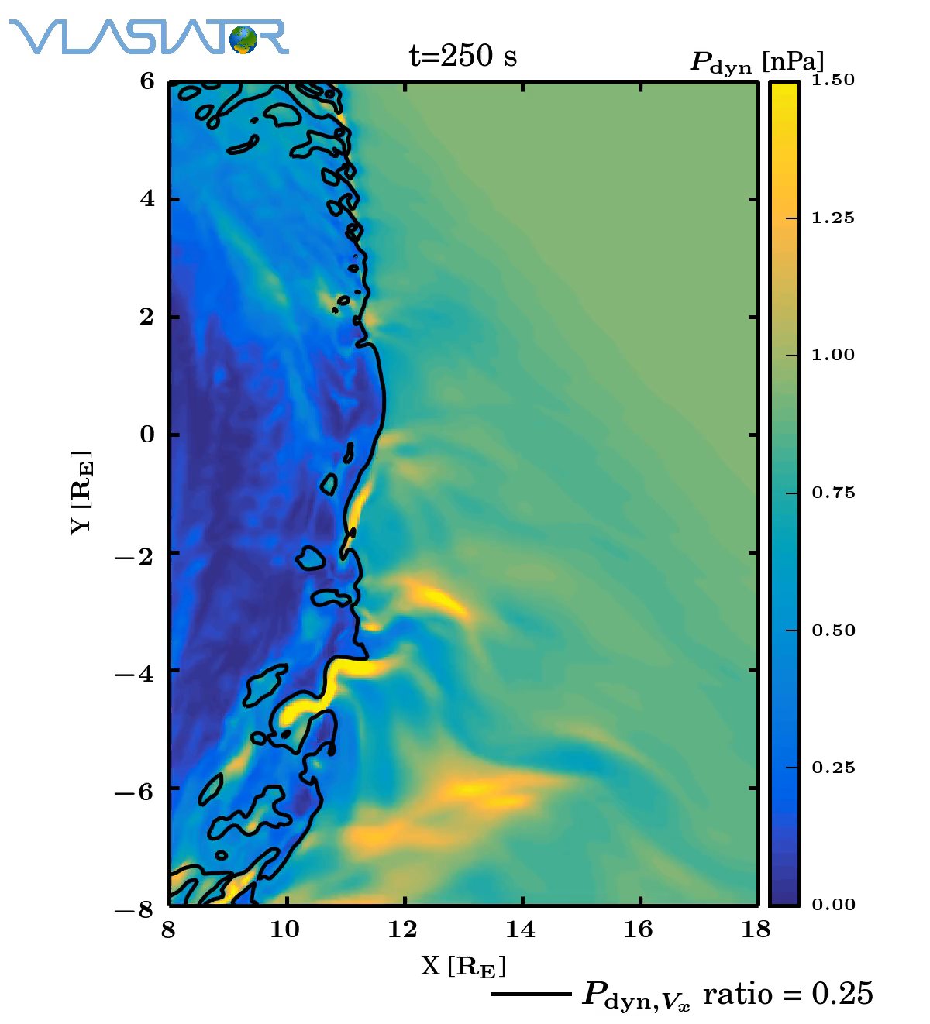
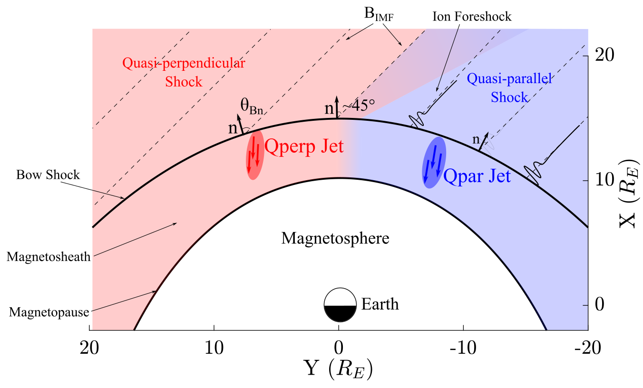
Ongoing work – Approaching the shock
Palmroth M., Raptis S., et al. (2020) | Annales (under review)
Palmroth M., et al. (2018) | Annales
Raptis S., Aminalragia-Giamini S., et al. (2020) | Frontiers

Slide 15
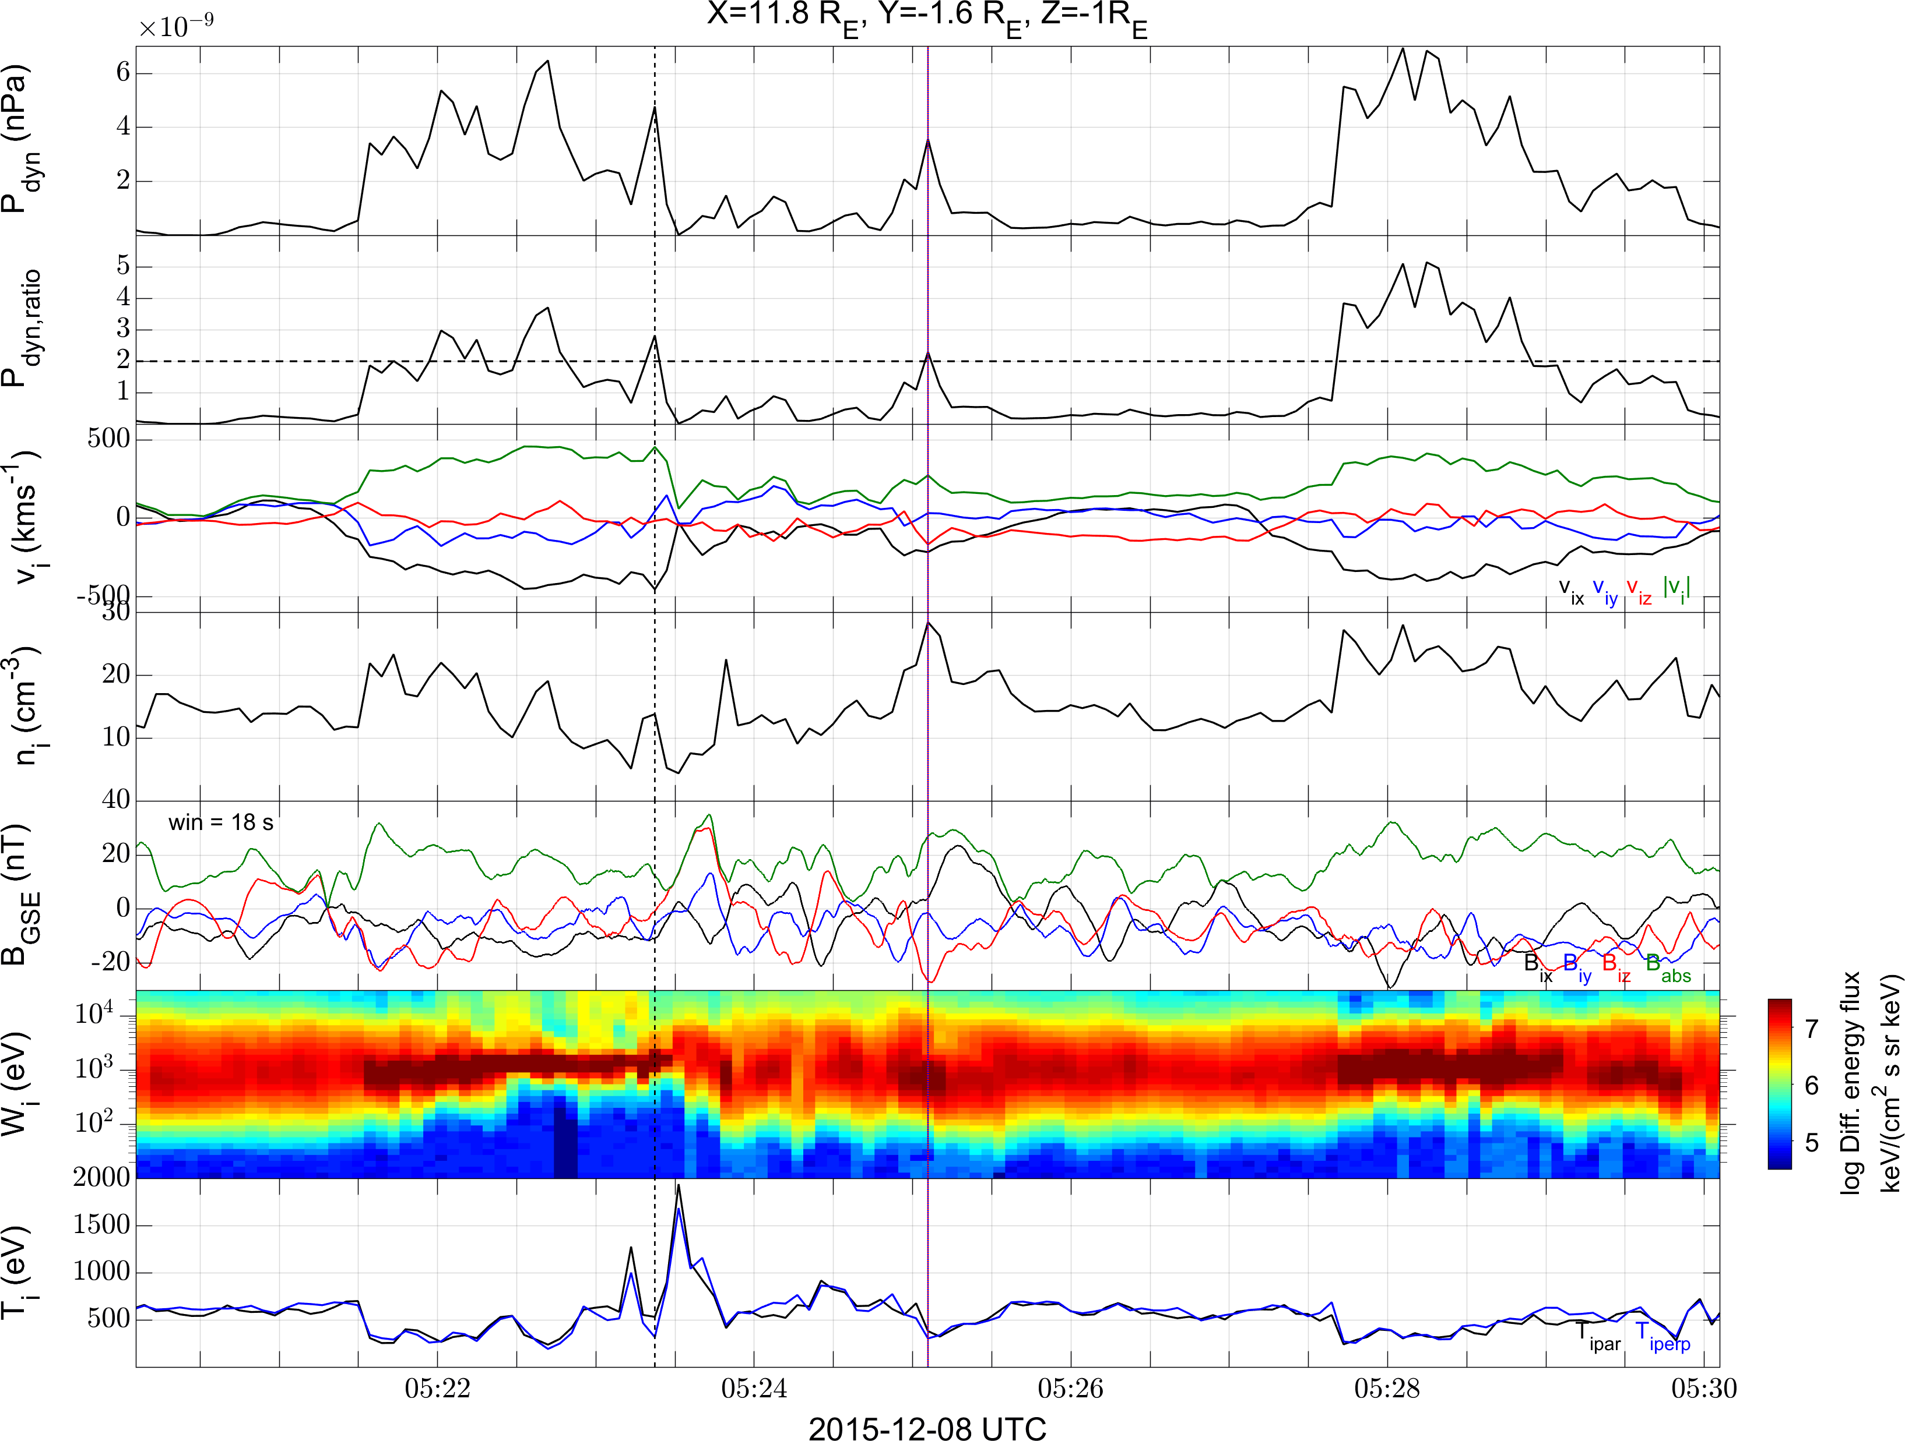
Close to the bow shock jet
Raptis, Karlsson, et al. | Ongoing

Slide 16
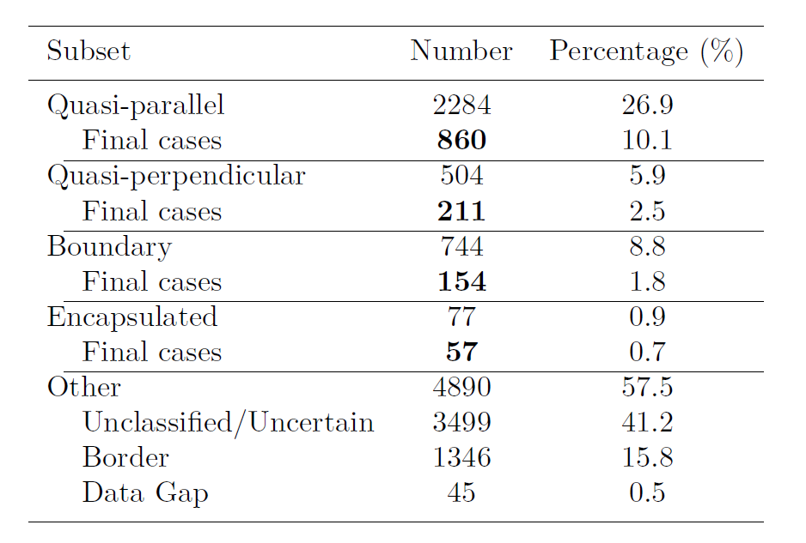
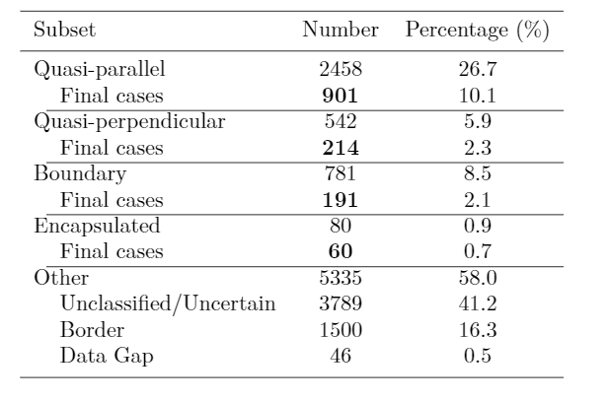
Updated database of jets
Initial: N = 8499
Updated: N = 9196
09/2015 - 04/2019
9/2015 - 9/2020
Raptis S., Karlsson T., et al. (2020) | JGR
Raptis S., Aminalragia-Giamini S., et al. (2020) | Frontiers
Palmroth M., Raptis S., et al. (2020) | Annales (under review)
Raptis, Karlsson, et al. | Ongoing

Slide 17
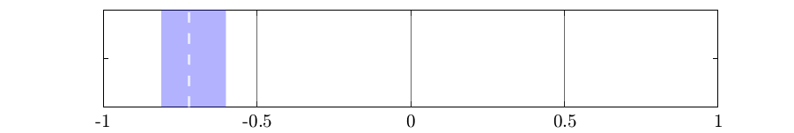
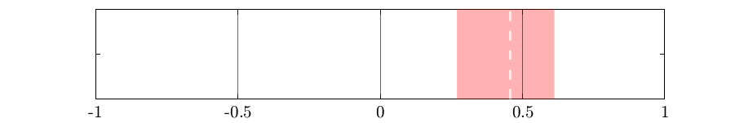
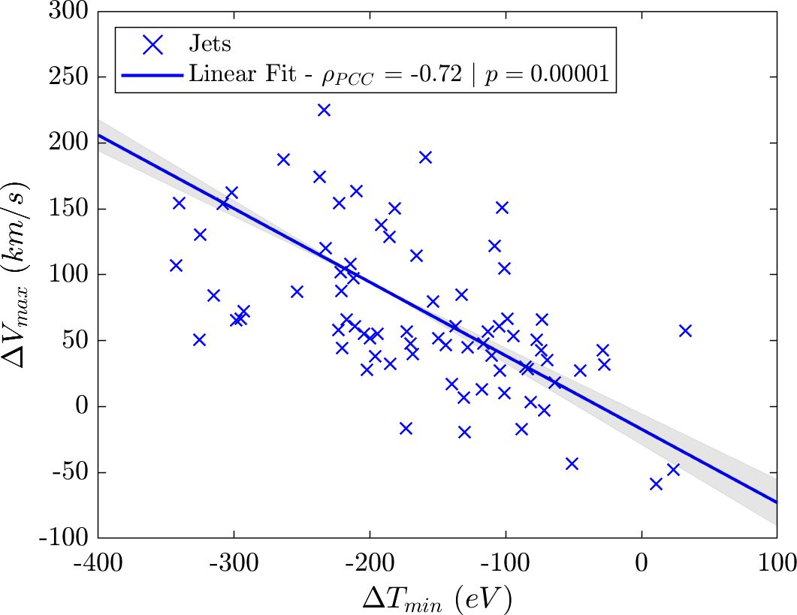
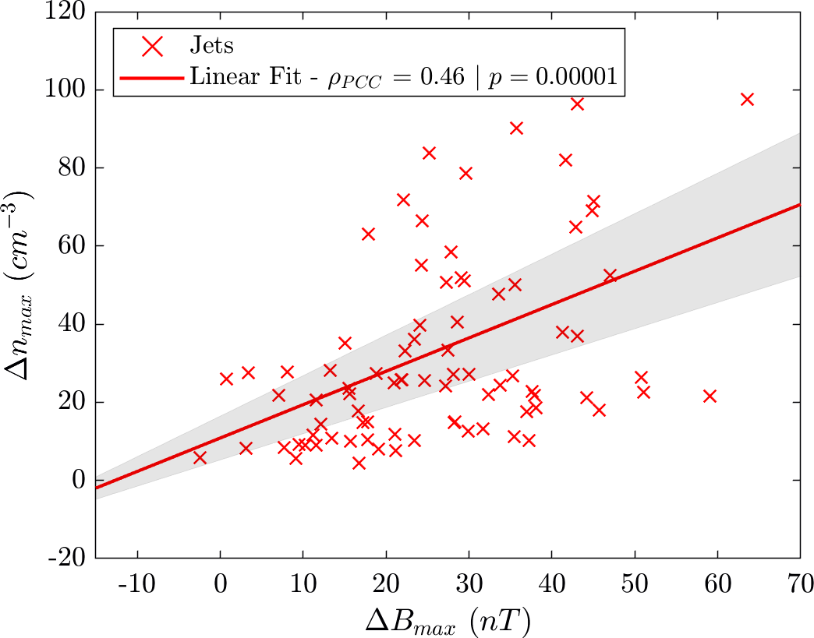
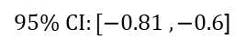
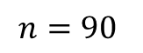
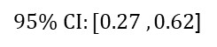
Ongoing Results
Ripples
$$n=90$$
SLAMS
$95\% CI:[−0.81 , −0.6$]
$95\% CI:[0.27 , 0.62$]
Raptis, Karlsson, et al. | Ongoing

Slide 18
Summary & Conclusion
Good indication that existent mechanism are at least partially responsible for what we see.
Quite a few things to be done:
See class specific correlations close to the bow shock.
Check other tools of connecting mechanisms (time series analysis, mutual information, prediction power scores, machine learning etc.)
Search for other generation mechanisms (e.g. reconnection Preisser et. al. 2020 | ApJL).
Inspect for statistical artifacts (e.g. partial shock crossings)
Excited results in the upcoming months!

